Slide 1

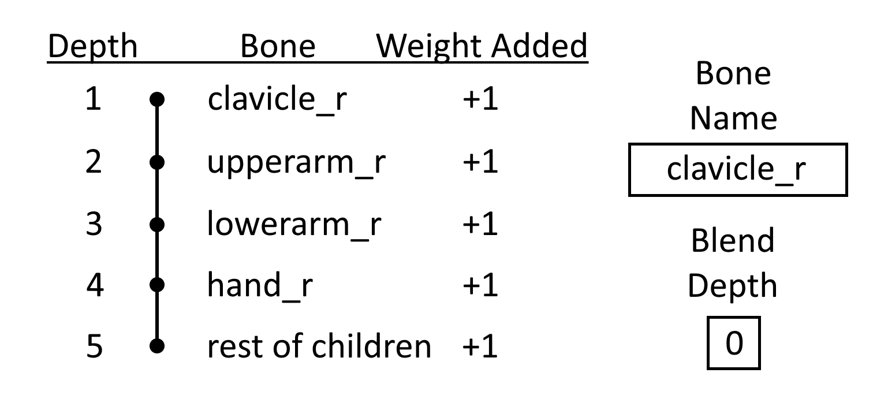
Branch Filters

Slide 2
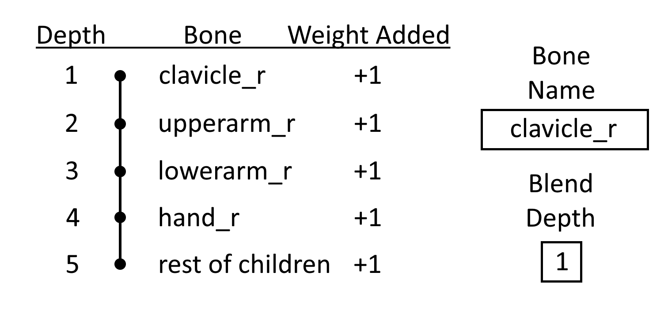
Branch Filters

Slide 3
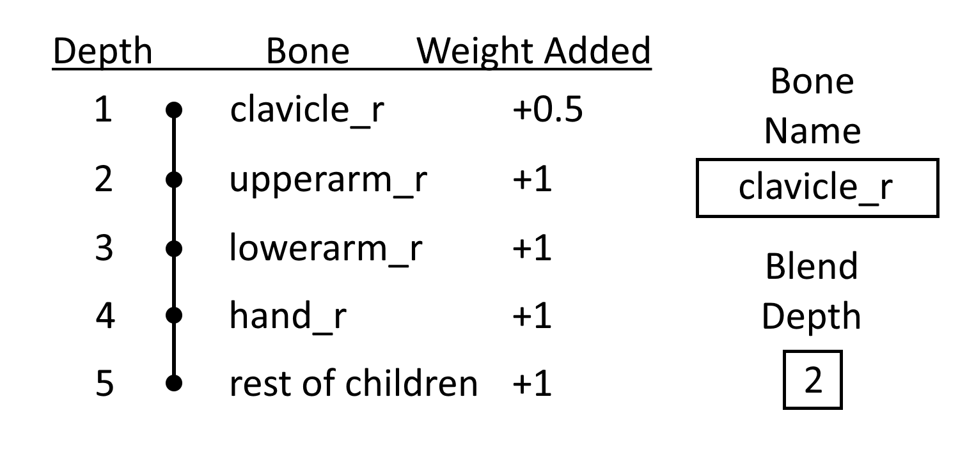
Branch Filters

Slide 4
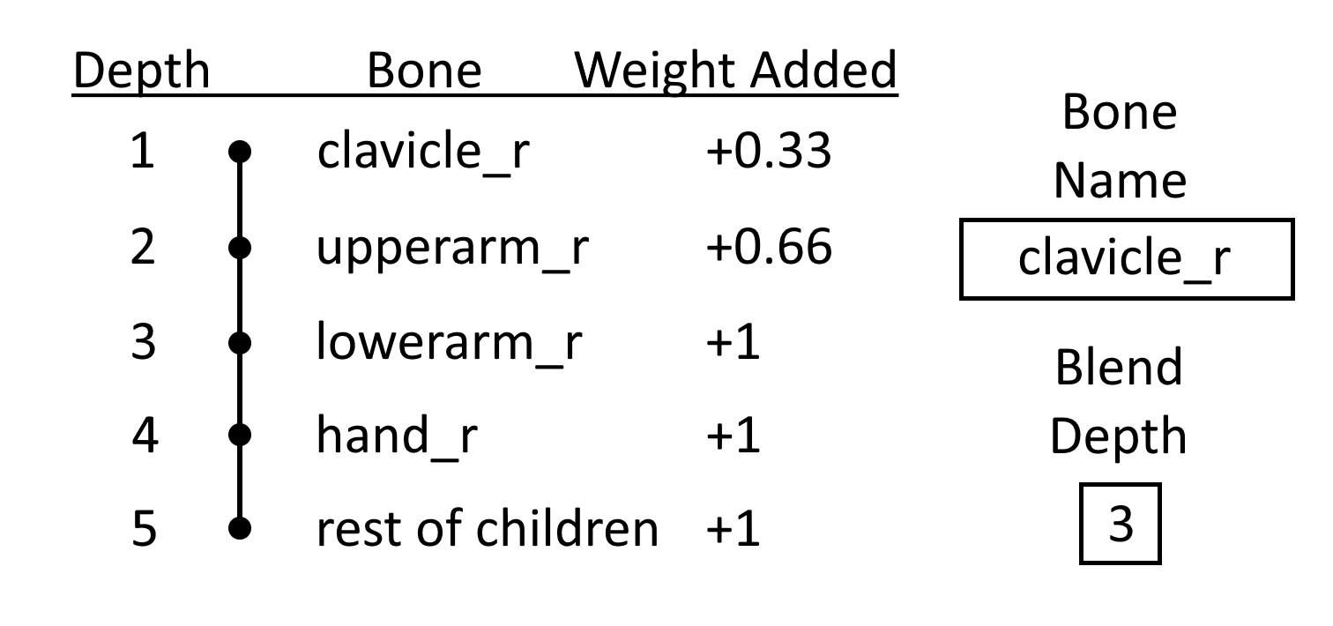
Branch Filters

Slide 5
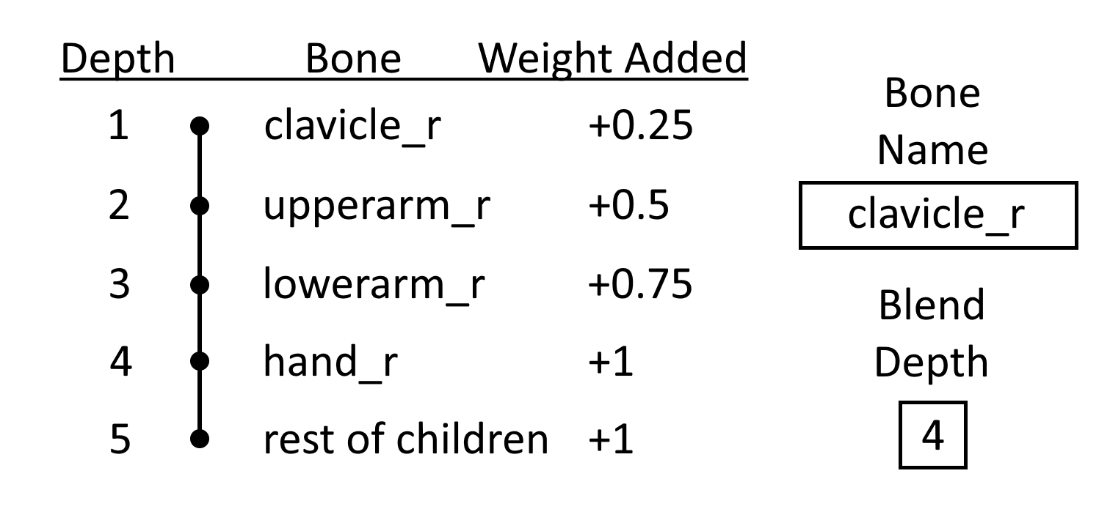
Branch Filters

Slide 6
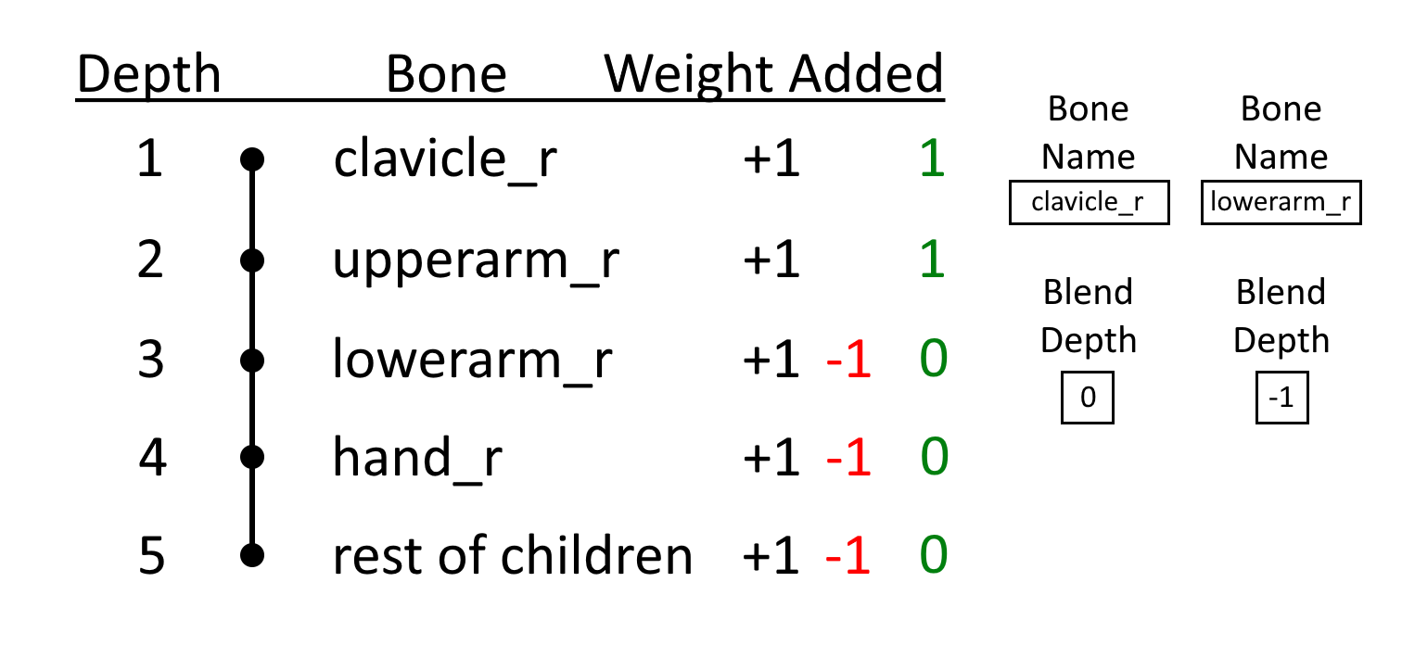
Branch Filters

Slide 7
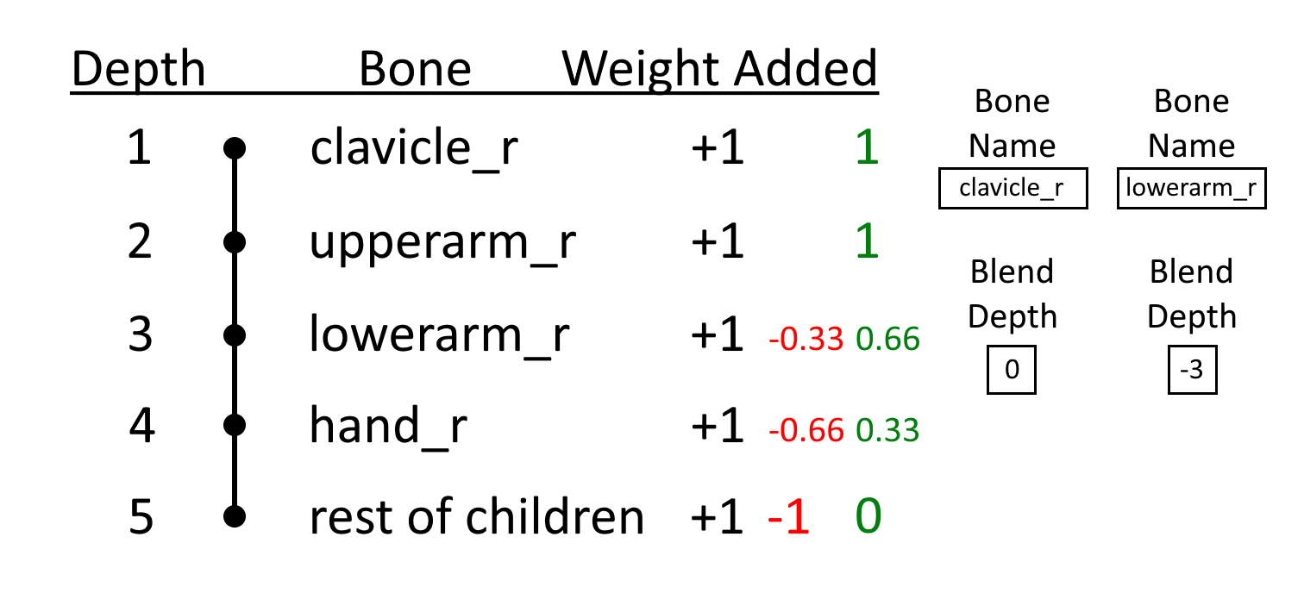
Branch Filters

Slide 8
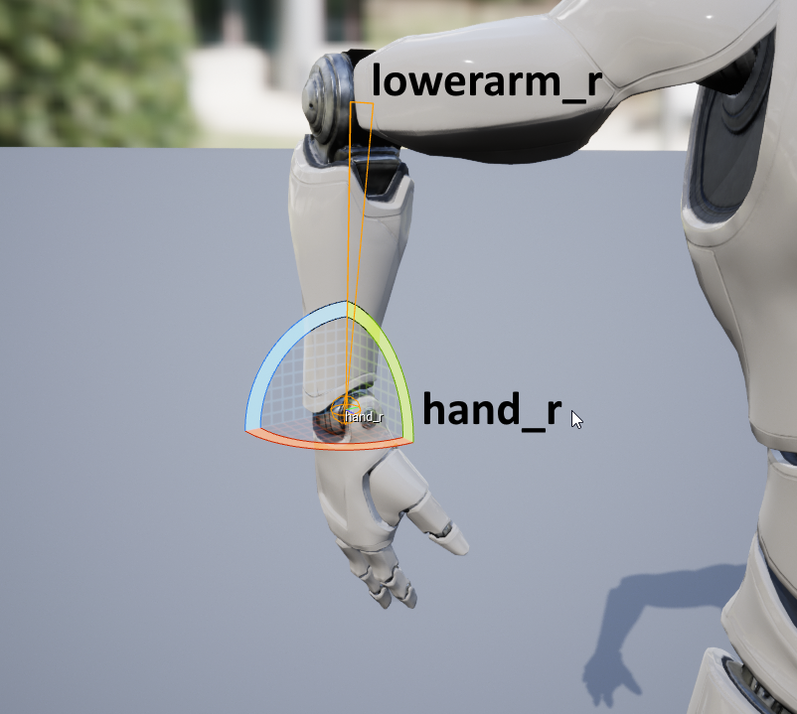
Local Space vs Mesh Space

Slide 9
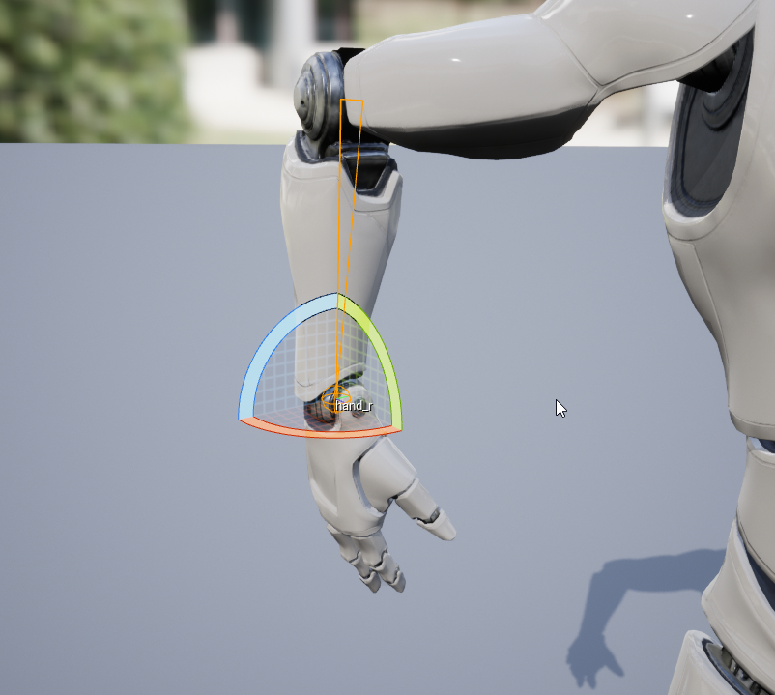
Local Space vs Mesh Space

Slide 10
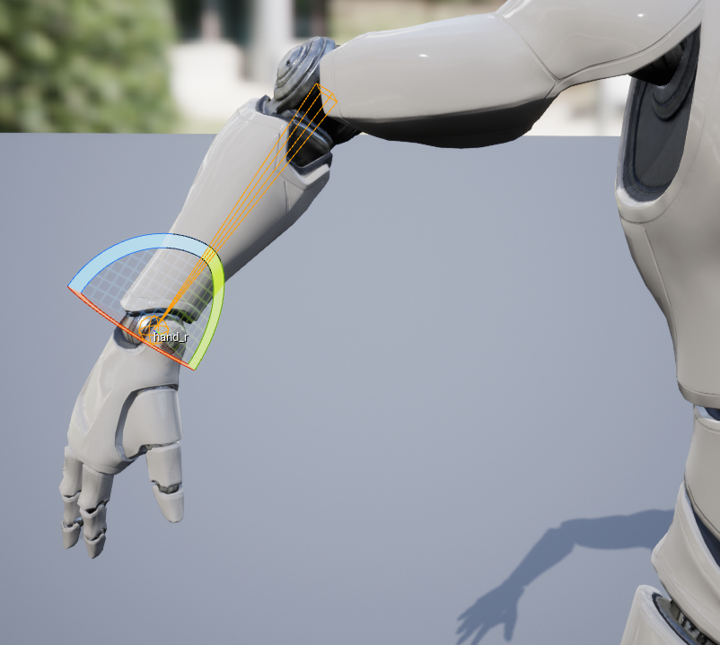
Local Space vs Mesh Space

Slide 11
Local Space vs Mesh Space

Slide 12
Local Space vs Mesh Space

Slide 13
Local Space vs Mesh Space

Slide 14
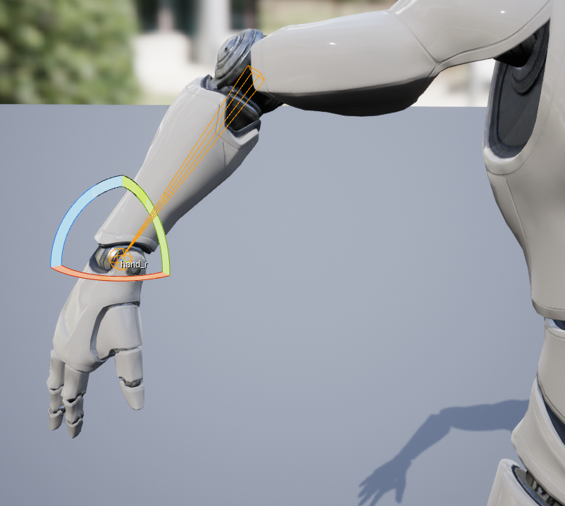
Local Space vs Mesh Space

Slide 15
Local Space vs Mesh Space

Slide 16
Local Space vs Mesh Space

